Slide 1



CHURN PREDICTION IN CLINICAL TRAILS

Slide 2

TEAM DETAILS:
S.no | STUDENT NAME | REG.NO
1 | P.PRUDVI VENKAT | 99220040334
2 | A.SURYA PRAKASH REDDY | 99220040385
3 | N.NANDU | 99220040313
4 | P.VAMSHI | 99220040340

Slide 3
PROBLEM STATEMENT:
The primary challenge in clinical trials lies in the effective recruitment and retention of participants, which are critical for the success and validity of a study. High dropout rates and difficulties in attracting suitable participants can delay timelines, increase costs, and compromise data integrity. This issue is further complicated by stringent inclusion/exclusion criteria, geographic barriers, and the demands placed on patients, such as frequent visits and complex protocols. Addressing these obstacles is essential to ensure clinical trials are completed efficiently and deliver reliable, meaningful results.

Slide 4
WHY WE HAVE CHOOSEN ??
We selected this problem because patient recruitment and retention are critical challenges in clinical trials, directly affecting the reliability, cost, and efficiency of medical research.
High dropout rates and recruitment difficulties can delay timelines, increase expenses, and reduce data quality, impacting the development of new treatments.
Influenced by factors like eligibility criteria, geographic barriers, and patient burden, this complex issue is well-suited for a data-driven approach.
By leveraging predictive modeling and personalized retention strategies, our project aims to streamline trial processes, benefiting both researchers and patients, and accelerating healthcare advancements.

Slide 5
THE PROJECT AIMS TO HAVE:-
The Dataset May contain:-
Patient Demographics: Age, gender, race, ethnicity, geographical location.
Enrollment Stage: Screening, informed consent, randomization, treatment initiation, follow-up.
Dropout Reasons: Lost to follow-up, adverse events, protocol violations, patient withdrawal, etc
The Goals to identify:-
Identify bottlenecks: Pinpoint stages of the trial where patients are most likely to drop out.
Optimize recruitment strategies: Develop more effective methods for attracting and enrolling eligible patients.
Visualization:-
Bar Charts:Visualize the number of patients at each stage of the trial.
Compare enrollment rates across different demographics or geographic regions.

Slide 6
REAL TIME EXAMPLE:-
Objective: The trial aims to test whether this new medication effectively reduces headache symptoms and if it's safe for users.
Participants: 200 individuals who suffer from frequent headaches are selected. They're divided into two groups: 100 people receive the new medication (the treatment group), and 100 people receive a placebo (the control group).
Data Collection: Participants take the medication or placebo daily for one month. They're asked to report headache severity, frequency, and any side effects in a daily log.
Analysis: After the trial, researchers analyze data to see if the treatment group reported fewer headaches than the control group. They also compare the severity of headaches and any side effects.
Results: If the treatment group experiences a significant reduction in headache symptoms compared to the control group with minimal side effects, researchers conclude the medication is effective and safe. Otherwise, adjustments are made for further testing or improvement.
Functionality for WebsHe Website DevelopmeThis type of analysis helps researchers determine if a new medication is effective and safe before it becomes widely available.

Slide 7
ABSTRACT:
This clinical trial analysis project aims to enhance trial success by addressing key challenges in patient recruitment, retention, and data variability.
Using advanced statistical and machine learning techniques, the study analyzes patterns in patient demographics, enrollment stages, and retention behaviors to identify factors impacting trial outcomes.
A data-driven framework is developed to predict dropout risk, providing tailored recommendations to improve retention.
This approach delivers actionable insights to streamline clinical trial processes, boost patient engagement, and support more reliable, efficient medical research.

Slide 8
INTRODUCTION:
Clinical trials are essential to the development of new medical treatments, providing the data necessary to assess the safety, efficacy, and optimal application of drugs and therapies.
This project addresses the critical challenges of patient recruitment and retention in clinical trials, which are essential for assessing new medical treatments.
In this project, we aim to enhance clinical trial success by predicting patient churn—whether a participant is likely to continue in the study or drop out.
Using machine learning models like Random Forest, XGBoost, and Gradient Boosting, we predict patient dropout risk based on demographics and enrollment data. Key factors such as age, location, and enrollment stage are analyzed to identify high-risk participants.
Additionally, we have developed a web application that allows trial coordinators to access these predictions and insights, enabling proactive strategies to reduce dropout rates and improve trial efficiency.

Slide 9

OBJECTIVES:
Predict Patient Dropout Risk
Identify Key Dropout Factors
Generate Retention Recommendations
Enhance Patient Retention
Analyze Demographic Influence
Provide Real-Time Insights
Optimize Trial Efficiency
Time Saving and cost reduction

Slide 10
CHALLENGES:
Data Quality and Availability: Obtaining high-quality and comprehensive symptom data from patients can be
Challenging and Inconsistent and incomplete clinical data can affect model accuracy.
Algorithm Complexity and Interpretability: algorithms used for disease prediction can be complex and difficult to interpret
Patient Privacy: Ensuring data security and compliance with regulations like HIPAA and GDPR.
Model Interpretability: Making machine learning predictions understandable for non-technical users.
Generalization: Developing models that work across diverse trials and patient populations.
Complex Feature Selection: Identifying key factors that influence patient retention from complex, multi- dimensional data
Real-Time Processing: Ensuring the web platform provides timely, accurate predictions and recommendations.

Slide 11
DATASET AND MODEL DESCRIPTION:
The dataset for this clinical trial project comprises several key features aimed at predicting patient dropout and retention. It includes patient demographics such as age, gender, race, ethnicity, and geographical location, which may influence the likelihood of a patient dropping out. The dataset also captures enrollment stages, covering milestones like screening, informed consent, randomization, treatment initiation, and follow-up, providing insights into the patient's progression throughout the trial. Additionally, dropout reasons such as loss to follow-up, adverse events, protocol violations, and patient withdrawal are recorded, helping to identify the main causes of attrition. Each patient is assigned a unique patient ID, linking their demographic and trial-related data. The target variable, churn, is used to predict whether a patient will continue with the trial (0) or drop out (1), enabling the development of strategies to enhance patient retention and reduce dropout rates.

Slide 12
WORK FLOW / METHODOLOGY:
Problem Analysis
Data Collection and Preprocessing
Data Visualization ,Model Selection
Model Development and Training
Model Evaluation and Optimization
Deployment and Maintenance

Slide 13
TECHNICAL STACK USED:
In this project standard libraries for information analysis and model creation are used. The following libraries are utilized in this project:
Python Libraries:
Pandas for data manipulation and cleaning.
NumPy for numerical operations.
SciPy for statistical operations and hypothesis testing.
Data Visualization:
Matplotlib and Seaborn for generating plots and visualizing data distributions, trends, and relationships between features.
Machine Learning Libraries :Scikit-learn for building and evaluating models such as Random Forest, Gradient Boosting, and XGBoost and Model Evaluation:Scikit-learn metrics for evaluating model performance with accuracy, precision, recall, F1-score, and AUC.
Web Development : Html,Css,Js

Slide 14
ALGORITHMS USED:
In this project, we elect to figure with some machine learning algorithms and which are:
Random Forest:A robust ensemble learning method that builds multiple decision trees and merges their results to improve accuracy and reduce overfitting. It’s great for handling complex data with many features and can manage both classification and regression tasks.
XGBoost:A gradient boosting technique known for its efficiency and high performance. XGBoost builds trees sequentially, where each tree corrects the errors made by the previous one. It’s well-suited for imbalanced data and large datasets.
Gradient Boosting:Another powerful boosting method that creates decision trees sequentially, focusing on the hardest-to-predict data points. It improves predictive accuracy by combining multiple weak models into a strong one, often used for classification tasks.

Slide 15
SYSTEM DESIGN:
The overall churn prediction in clinical trail system performs supervised learning algorithm which is the crux of the system and develops an web application.
The user needs to enter the unique patient id first.
After that all the patient information will be display and it will ask weather you need to predict churn or not
If you need to predict press yes
Then it will tell weather the patient will continue or dropout.
And if the patient wants to dropout it will show recommendations to reduce the dropout rate at that particular stage.

Slide 16
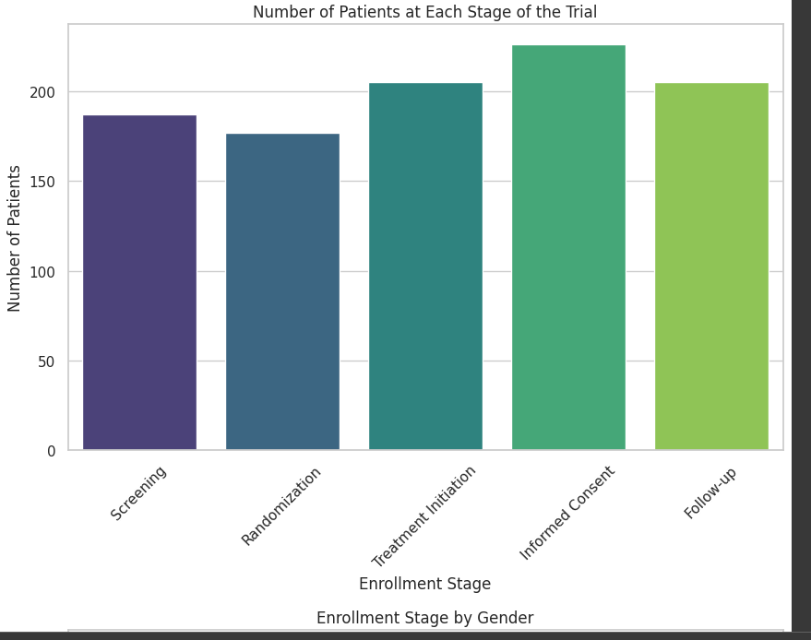
Visualization :

Slide 17
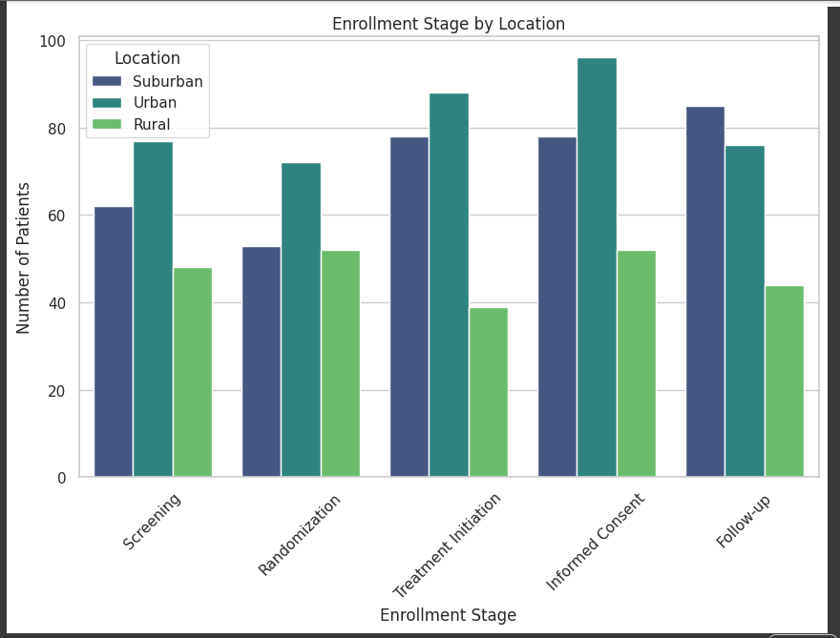

Slide 18
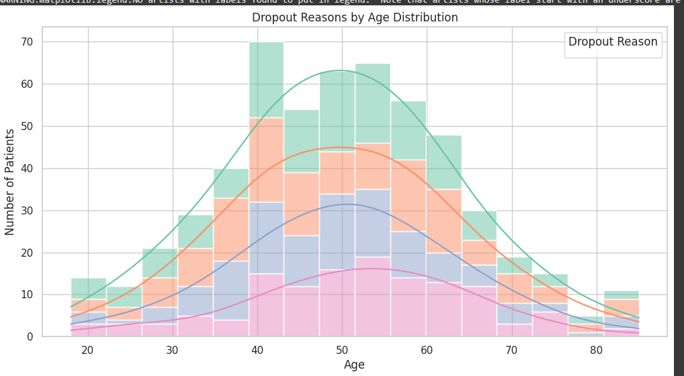

Slide 19
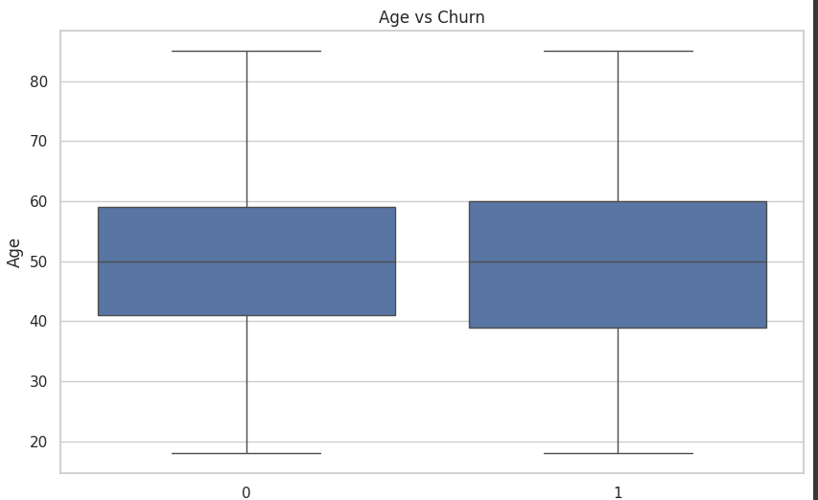

Slide 20
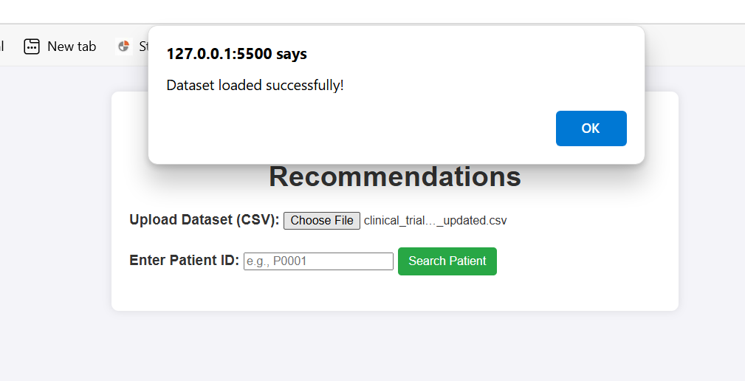
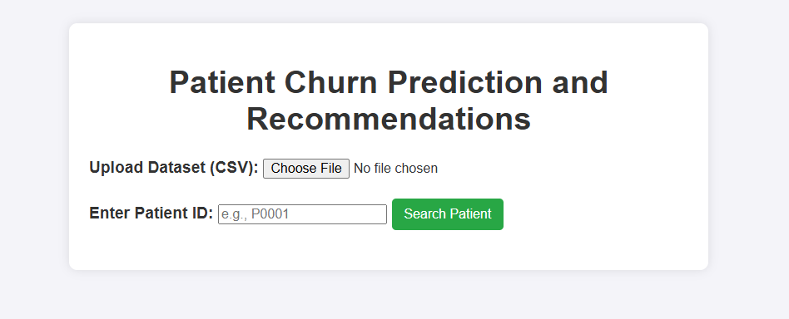
OUTPUT:

Slide 21
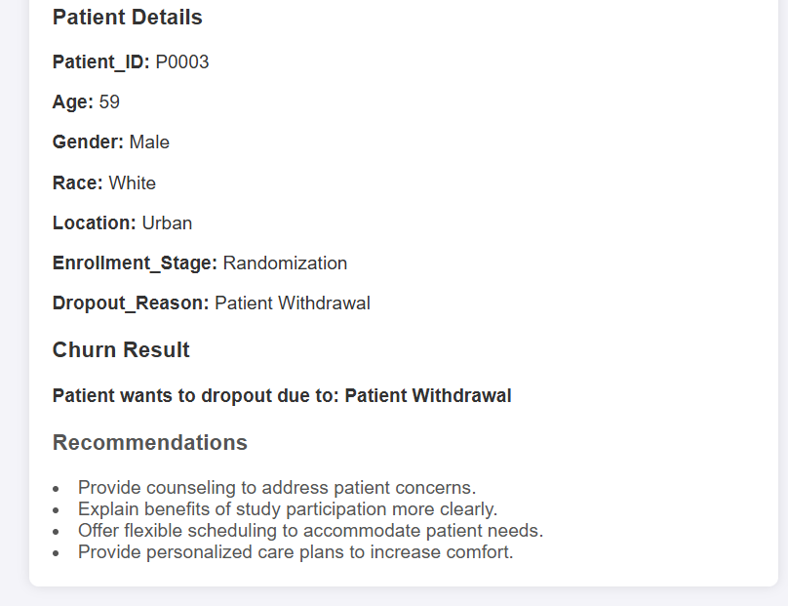
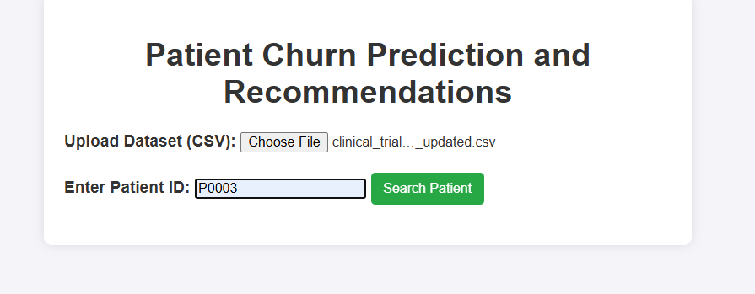
OUTPUT:

Slide 22
FUTURE SCOPE:
Advanced Algorithm Integration: Exploring deep learning and ensemble methods for improved prediction accuracy.
Multi-Modal Data Incorporation: Extending to genetic, imaging, and omics data for comprehensive prediction.
Real-Time Monitoring and Telemedicine: Enabling remote consultations and proactive disease
monitoring.
Explainable AI Implementation: Ensuring transparency and trust through interpretable predictions.
Global Deployment and Accessibility: Addressing barriers for widespread access and utilization worldwide.

Slide 23
CONCLUSION:
This clinical trial prediction project successfully leverages advanced machine learning algorithms—Random Forest, XGBoost, and Gradient Boosting—to predict patient dropout risks and improve retention strategies. By analyzing key factors like demographics, enrollment stages, and dropout reasons, the model provides valuable insights that help trial coordinators intervene early and personalize retention strategies. The development of a user-friendly web platform ensures real-time predictions and actionable recommendations, ultimately enhancing trial efficiency, reducing costs, and improving patient engagement. This approach holds significant potential to optimize clinical trial outcomes and contribute to more successful and efficient clinical research.

Slide 24
THANK
YOU

